Slide 1
Window Programming 2-6
Integrated example: Piano
Yuan Ze University

Slide 2
Integrated example: Piano
Console.Beep(int frequency, int duration)
  Do: 262
  Re: 294
  Mi: 330
  Fa: 349
  Sol: 392
  La: 440
  Si: 493
  Do: 523

Slide 3
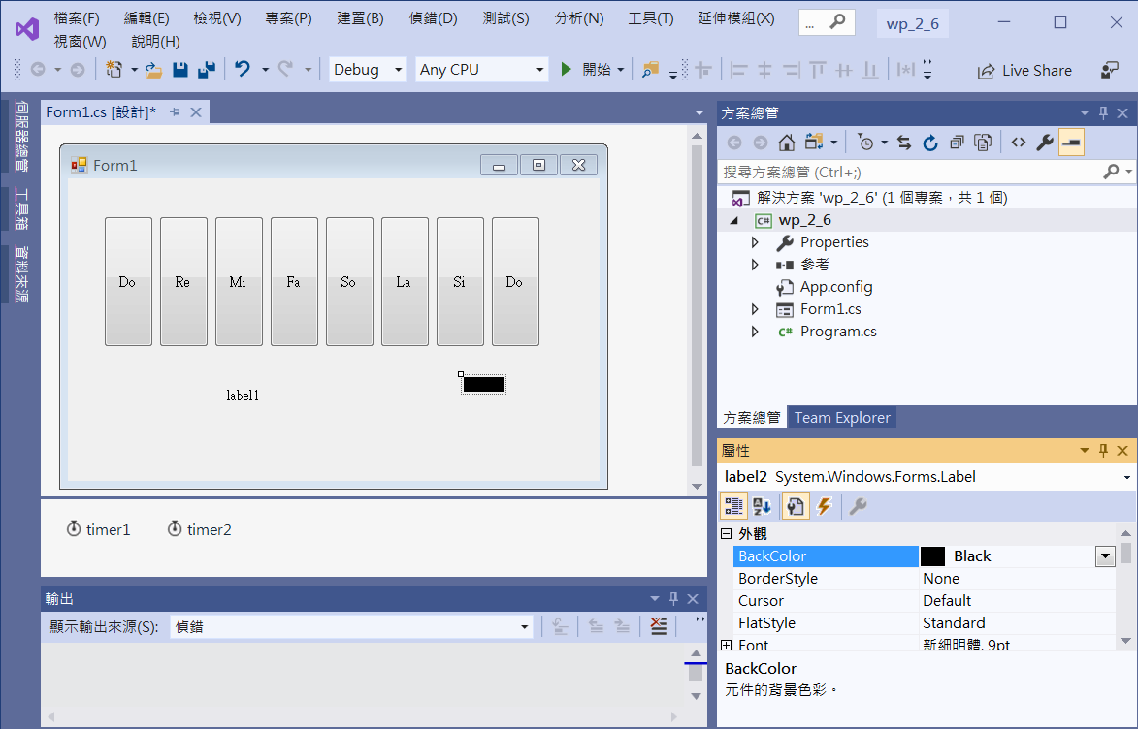
Edit interface
Button1~8
label2
label1
label2
BackColor -> Black
timer1
1000 ms
timer2
500 ms

Slide 4
Add event functions
private void button1_Click(object sender, EventArgs e)
{
Console.Beep(262, 500);
}
private void button2_Click(object sender, EventArgs e)
{
Console.Beep(294, 500);
}
private void button3_Click(object sender, EventArgs e)
{
Console.Beep(330, 500);
}
private void button4_Click(object sender, EventArgs e)
{
Console.Beep(349, 500);
}

Slide 5
Add event functions
private void button5_Click(object sender, EventArgs e)
{
Console.Beep(392, 500);
}
private void button6_Click(object sender, EventArgs e)
{
Console.Beep(440, 500);
}
private void button7_Click(object sender, EventArgs e)
{
Console.Beep(493, 500);
}
private void button8_Click(object sender, EventArgs e)
{
Console.Beep(523, 500);
}

Slide 6
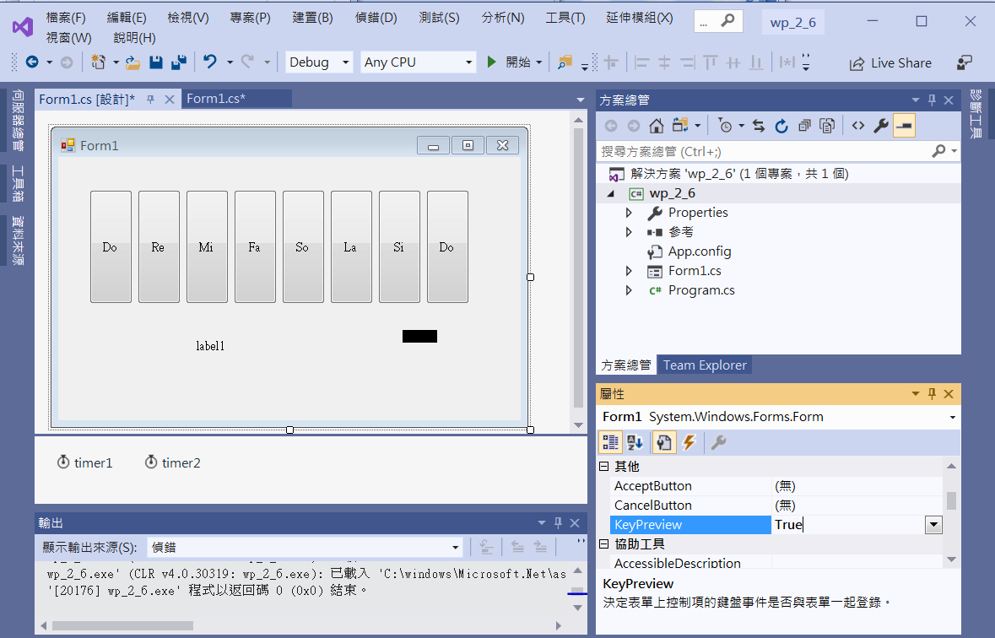
Keyboard input
KeyPreview -> true
啟動Form1的鍵盤事件

Slide 7
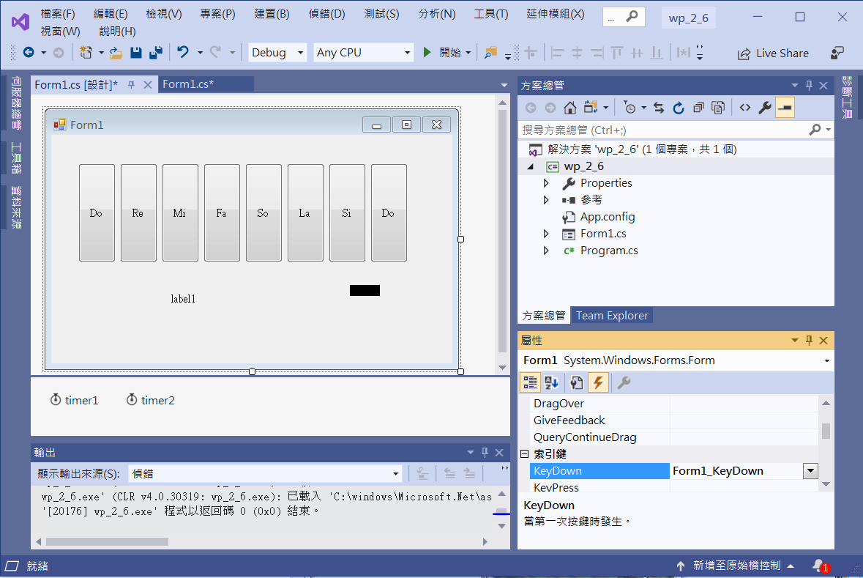
Keyboard input
Double Click at KeyDown

Slide 8
Keyboard input
private void Form1_KeyDown(object sender, KeyEventArgs e)
{
switch (e.KeyCode)
{
case Keys.D1:
Console.Beep(262, 500); break;
case Keys.D2:
Console.Beep(294, 500); break;
case Keys.D3:
Console.Beep(330, 500); break;
case Keys.D4:
Console.Beep(349, 500); break;
case Keys.D5:
Console.Beep(392, 500); break;
case Keys.D6:
Console.Beep(440, 500); break;
case Keys.D7:
Console.Beep(493, 500); break;
case Keys.D8:
Console.Beep(523, 500); break;
default:
MessageBox.Show("Wrong Input!"); break;
}
}

Slide 9
Timer event functions
private void timer1_Tick(object sender, EventArgs e)
{
label1.Text = DateTime.Now.ToString();
}
private void timer2_Tick(object sender, EventArgs e)
{
label2.Visible = !(label2.Visible);
}
private void Form1_Load(object sender, EventArgs e)
{
timer1.Start();
timer2.Start();
label1.Text = DateTime.Now.ToString();
}

Slide 10
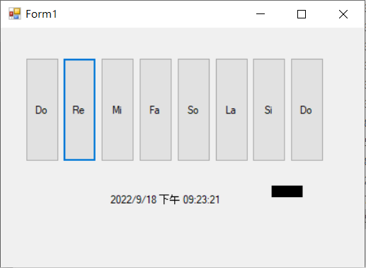
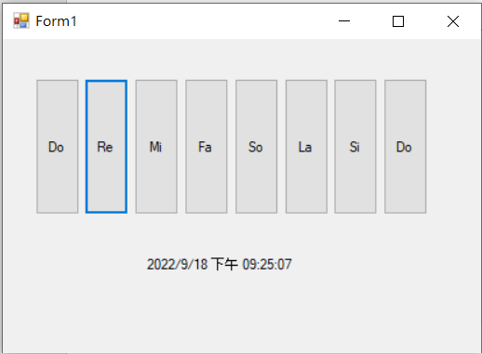
Exercise#2-6

Slide 11
內容來源
  Visual C# 2013視窗程式設計(黃聰明/著; 松崗)
  跟著範例學會Visual C# 2015(張逸中/著; 博碩)

